Slide 1


ORTHO EYES
Dr. Tony Andrioli​​
Arjun, Brice, Eddie, Hassan, Lennart, Rachelle, Raphael

Slide 2

General plan
Until now
Reproducing work from last group.​
Develop our skills in machine learning.
Waiting for the LUMC​
Next Week​
Evaluate machine learning model with different configurations​.
Futher working with NN

Slide 3

LUMC
Issues
Conversion mm/inch
Dummy data
Plans
Wait for LUMC
Manually label correct data with physician
Category 1-3 Category 4
5 1159.07 217.88 244.23
-0.29 0.64 0.71
-0.15 0.70 -0.70
-0.94 -0.31 -0.11
4 1164.88 164.31 -12.95
0.64 -0.69 0.35
0.76 0.47 -0.45
0.14 0.55 0.82
5 42.43 4.87 -3.11
0.767 0.576 -0.283
-0.522 0.816 0.246
0.373 -0.042 0.927
4 42.43 7.98 4.38
0.328 0.092 0.940
-0.796 -0.509 0.327
0.509 -0.856 -0.094

Slide 4
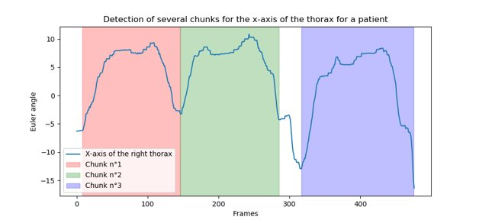
Splitting data-set
Group | Combinations
Before | 1856
Ater | 3437
Group | 1 | 2 | 3 | 4
Exercises | 300 | 218 | 186 | 176
N Splitted | 1 | 174 | 171 | 1

Slide 5
This week
Run all configurations for Linear Regression
Continuing with NN
CNN
LSTM

Slide 6
Questions?

